Slide 1
Final Presentation
summary of the results of the term project
Avi Manawat (Student Id: 109638446)

Slide 2

Business Problem
One of the common problems’ organizations face these days is to hold on to their old, loyal, and well-trained employees. Retention of a positive and motivated employee is very important for the organization's success. High employee turnover increases the expenses and has a negative impact on the organization’s morale.
We aim to attract all business to complete an “Employee Retention Course” from our website in order to solve the problem of high employee turnover rates and get the benefit of this course. Implementation of an employee retention program is an effective way of making sure that the pivotal workers remain employed while balancing and maintaining job performance and productivity.

Slide 3
Business Audience Affected
Software Companies have the highest employee turnover rate. There’s strong evidence to suggest that the trouble with retaining tech talent is high demand and rising compensation within the industry. As employers and compensation offers get more competitive, top talent is more eager to switch to better opportunities.
Retail and Consumer Products: The industries within retail with high levels of turnover aren’t terribly surprising. Retail stores constantly look for people good at marketing to increase its sale.
Media and entertainment companies: Talent needs would naturally flow faster here as compared to other sectors, resulting in more turnover.

Slide 4
Dimensions and Measures to look out for
Bounce Rate
Loyalty in visitor behavior
Depth of visit
Browsers
Conversion Rate

Slide 5
Analysis on Google Analytics Demo Account for achieving the business goals

Slide 6

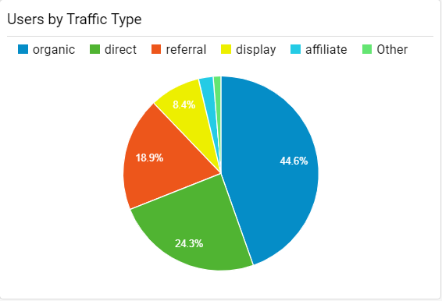
Users by Traffic Type
The pie chart classifies the composition of traffic observed on the website.
Increased proportion of organic visits is a positive sign for the website leading to brand awareness as these are the visits made to the website through search engines such as google and yahoo to the website against the number of paid visits.
A track over this will help to know when the organic and direct visits are decreasing and when there’s a need to invest in getting paid visits.

Slide 7
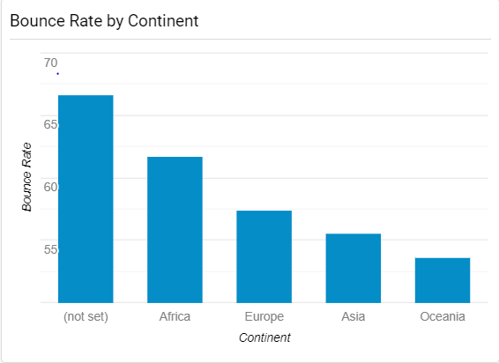
Bounce Rate By Continent
Bounce rate is one of the most important influencers, it shows the percentage of visitors that leave our website after visiting only one page. High bounce rate indicates low website performance. This bar chart denotes how bounce rate observed on the website varies with visitors from different continents.
Visitors from African continent have a high bounce rate and back away just after visiting the home page, while visitors from Asian and Oceania continents show lower bounce rate.
The aim is to reduce bounce rate by making the website more attractive and interesting to the visitors and holding them for as long as possible.

Slide 8
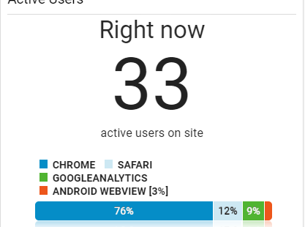
Real Time Metric
The metric gives real time view of visitors on the website along with specifying which browser are they using.
As mentioned, 33 people are currently active on the website with majority of them(76%) using the chrome browser followed by safari(12%) and so on.
The real time tracking can be used for a better customer experience by developing the right customer engagement strategy.

Slide 9
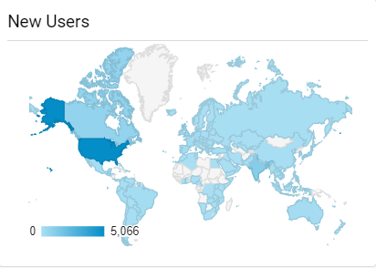
New Users by Country
This GeoMap represents the number of new users that visit the website from different parts of the world.
Though people from most parts of the world have made visits, the highest number of new visitors are from Unites States.
Determining where the new visitors on the website are coming from is important in analyzing the effectiveness of the marketing campaigns and formulating new marketing policies.

Slide 10

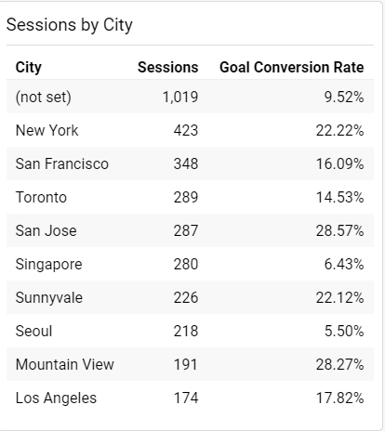
Sessions by City
This is the most important performer to look as it tracks what is the ultimate aim of creating the website i.e., conversion rate.
It reveals the percentage of visitors classified by cities who have taken the desired action as per our website’s goal, helping us know how good the performance of the website is to achieve our business goals.
The analysis assists greatly in the important process of decision making.

Slide 11
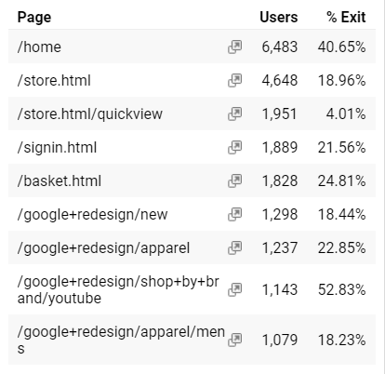
Users and %Exit by Page
The table explains the distribution of visitors on different pages of the website and the exit rate on that pages. It also helps understand hoe the visitors navigate through the website.
As observed here, high number of people exit from the home page as well as ‘/google+redesign/shop+by+brand/youtube’ page. On the other hand some pages have a significantly lower exit rate.
High exit rates on a particular page is something to watch for. Making changes or redesigning the page with high exit rates would help to hold on the visitors.

Slide 12
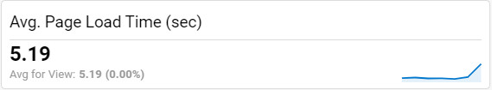
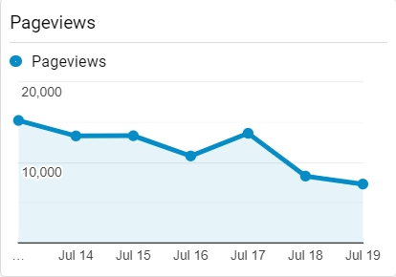
Average Page Load Time and Pageviews
The metric for Avg. Page Load Time shows the mean time taken by a page on the website to load. Keeping this time as low as possible is the key else we might end up loosing our visitors to our competitors.
The timeline chart represents the pageviews by day. The declining graph that the number of pageviews have decreased over the days. It needs to monitored over time to check the performance of the website.

Slide 13

Benefits of this Analysis
Reduce Risk: A proper use of this analytical skill will help the business keep a track over its activity, thus better control. This helps to reduce uncertainty.
Improved Decision Making: It will help the business determining its strong and weak zones. Different areas of the business can be targeted differently based on the performance.
Better Customer Experience: By analyzing the customer behavior and keeping track of their activities on the website, stakeholders of a business would know what their customers want and thus act accordingly.
High Profits: A satisfied customer makes repeated purchases thus increasing profit for the business.

Slide 14
Recommendations
Increasing number of organic sessions is good sign for any business but if these organic sessions keep reducing over time, the business has to look for alternative ways to attract new visitors. This could be done by investing money to get paid sessions.
In case of website having larger number of returning visitors indicate that the website has a good retention power, holding onto the first-time visitors. Here, the focus should be get more and more people among the target audience to make their first visit on the website. On the other hand if the website is able to attract new visitors but not able to hold them on, making structural and visual changes to the website should be looked upon.
When the bounce rate on the website is surprisingly high, improving the brand storytelling can help. The aim is to recognize how people read content, storytelling helps our content appeal to users in a dynamic, emotional way. As a result, they’ll begin to trust us more.
Oversized pictures can be removed or smaller sized pictures of the same can be used when the average load time of the website is high. This may also help in reducing the bounce rate.
Internal site search to optimize customers’ experience can be used to deal with dropping conversion rates

Slide 15

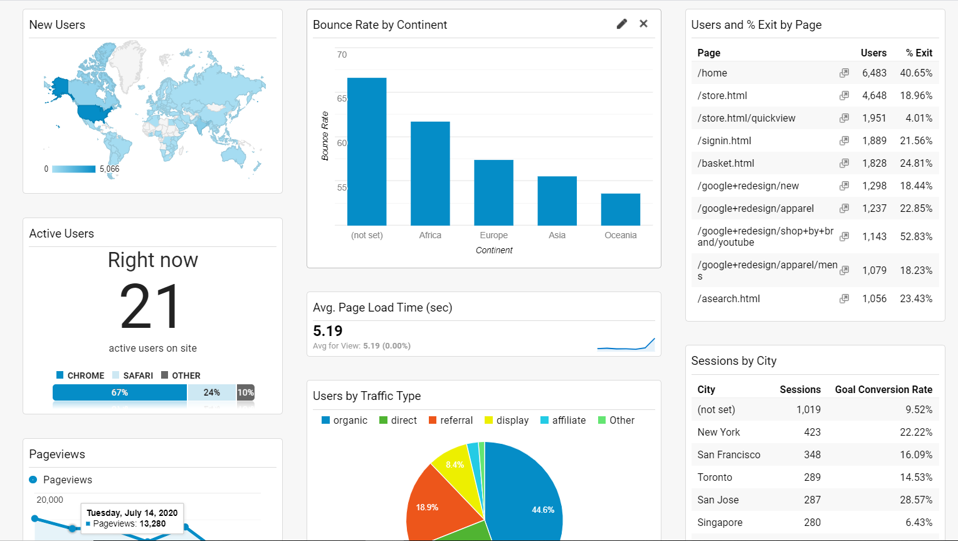
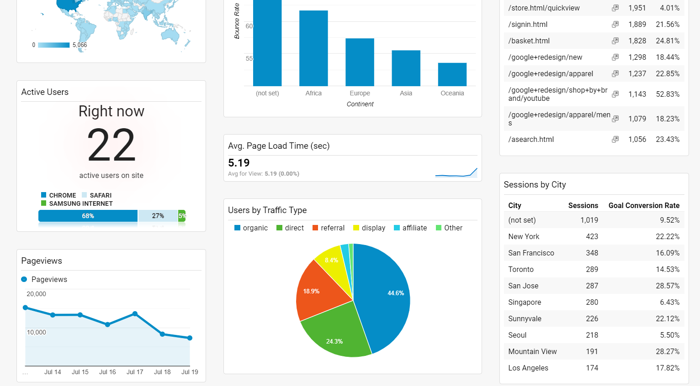
Dashboard
Link: https://analytics.google.com/analytics/web/template?uid=BrJQePWuT1-bRa0W28rTjg

Slide 16

Thank You

